Slide 1
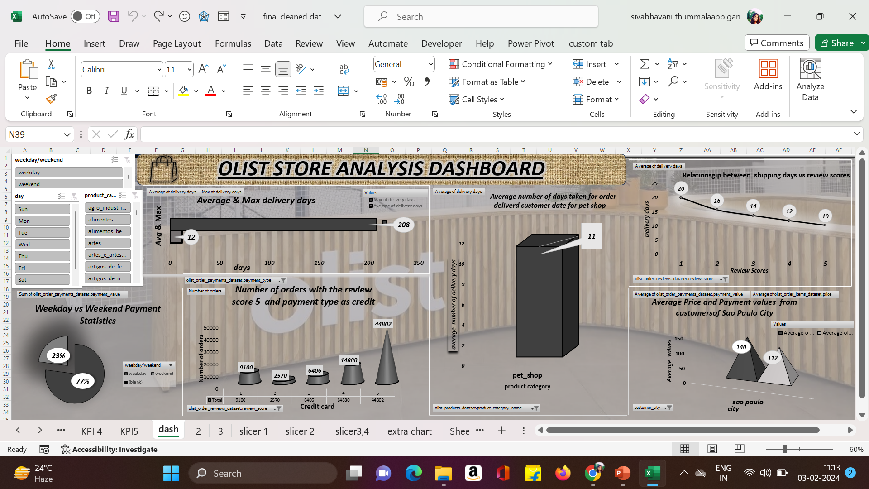

Slide 2
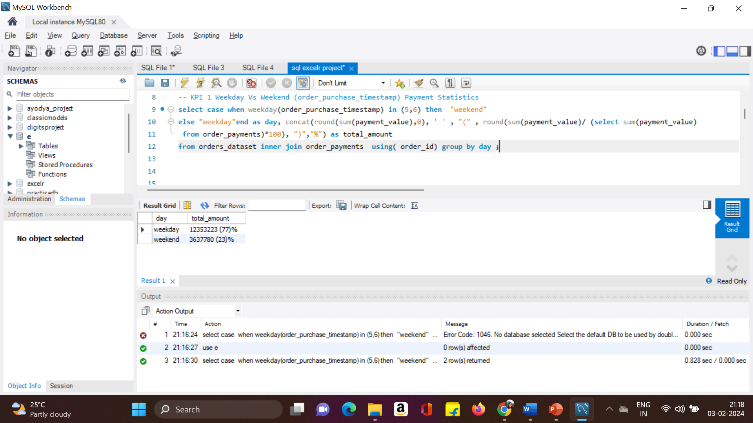
KPI -1)Weekday Vs Weekend (order_purchase_timestamp) Payment Statistics

Slide 3
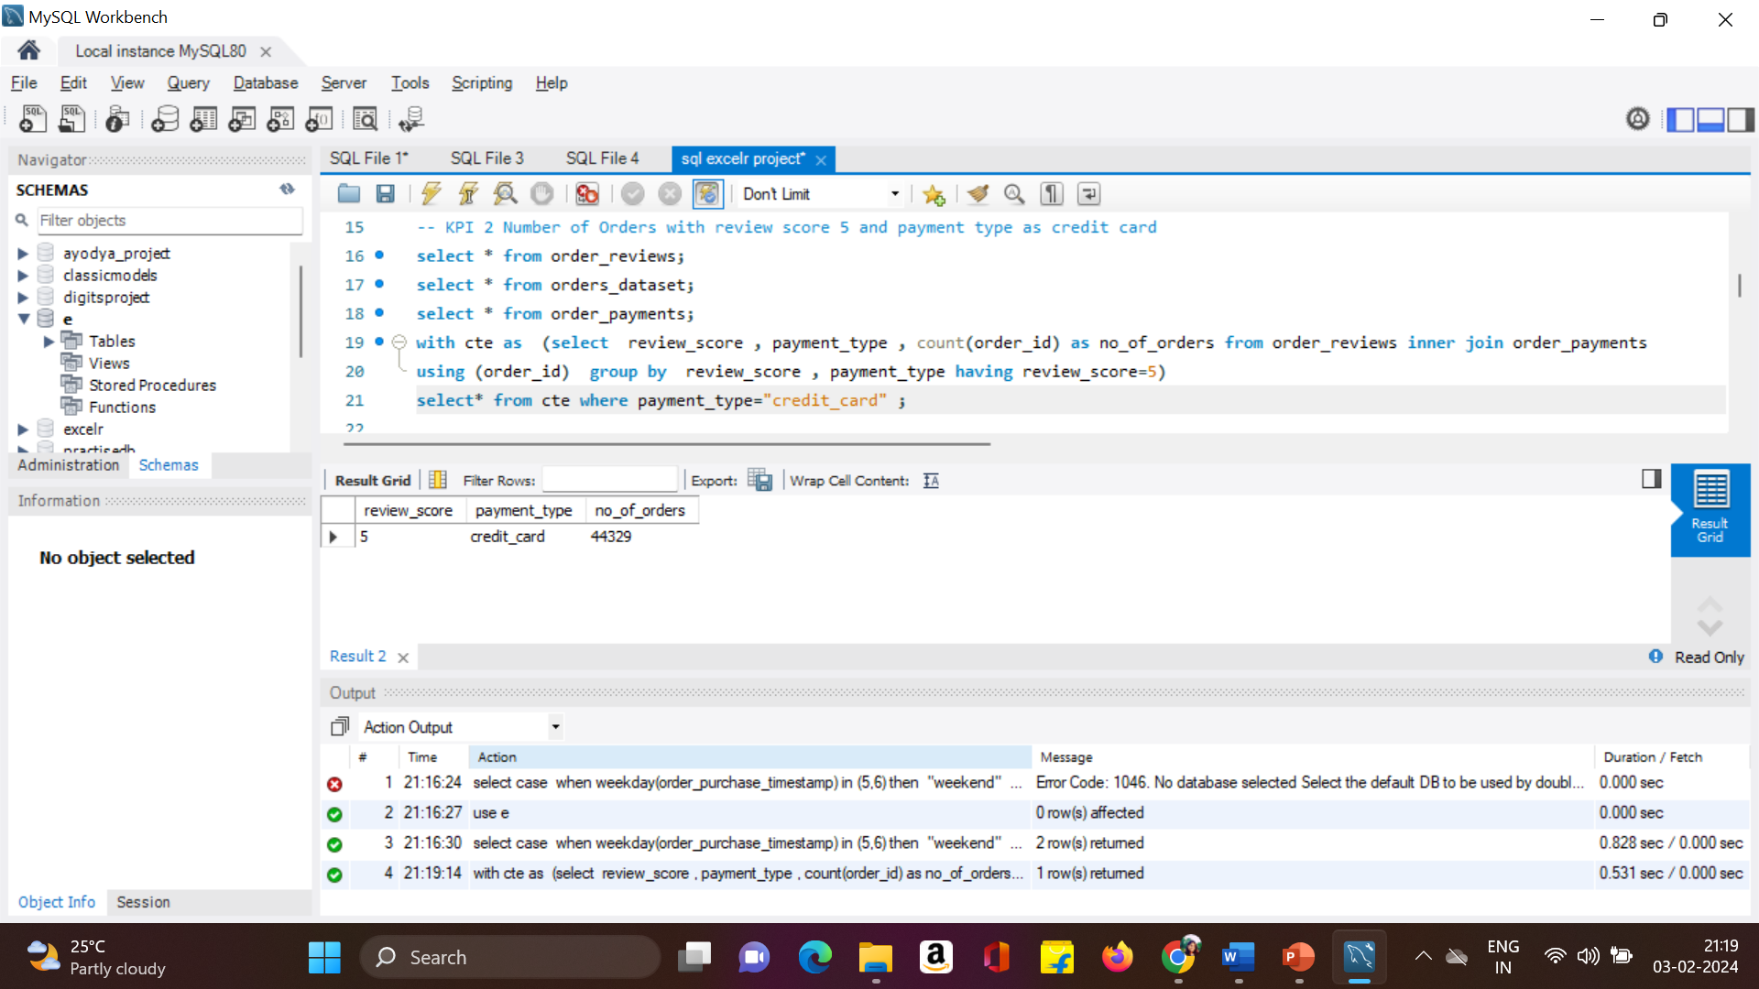
KPI 2) Number of Orders with review score 5 and payment type as credit card

Slide 4
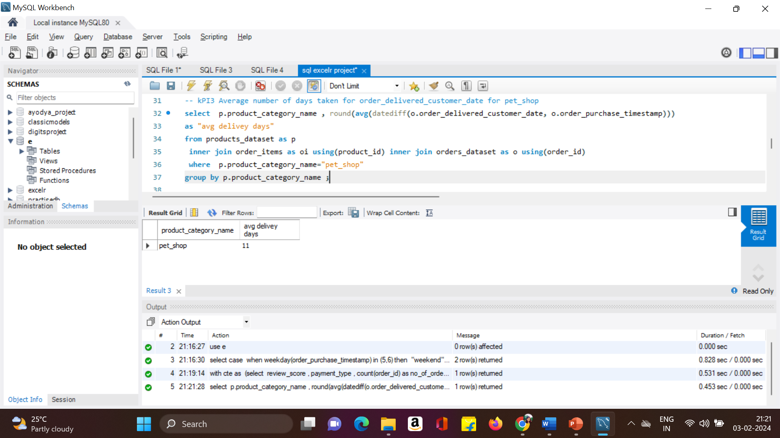
KPI 3) Average number of days taken for order_delivered_customer_date for pet_shop

Slide 5
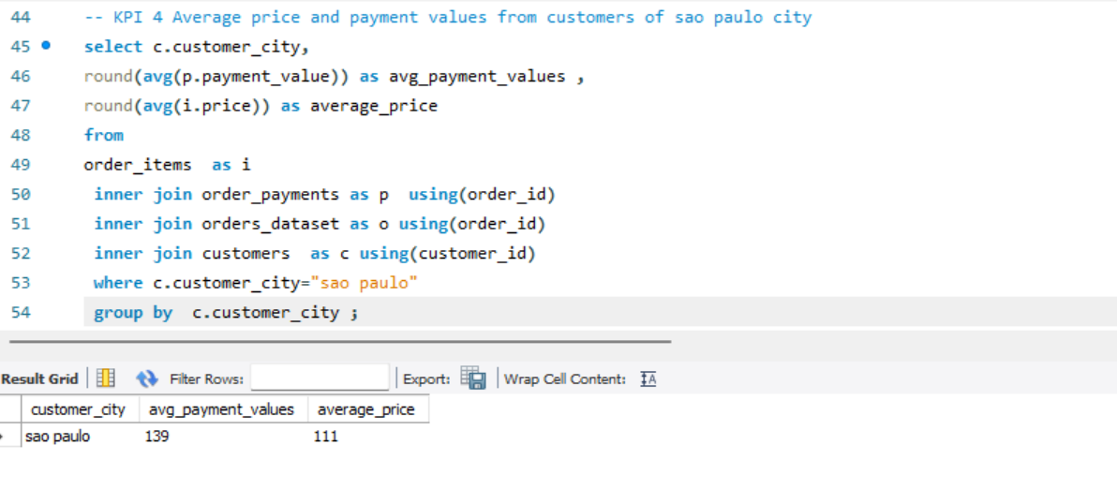
KPI 4) Average price and payment values from customers of sao paulo city

Slide 6
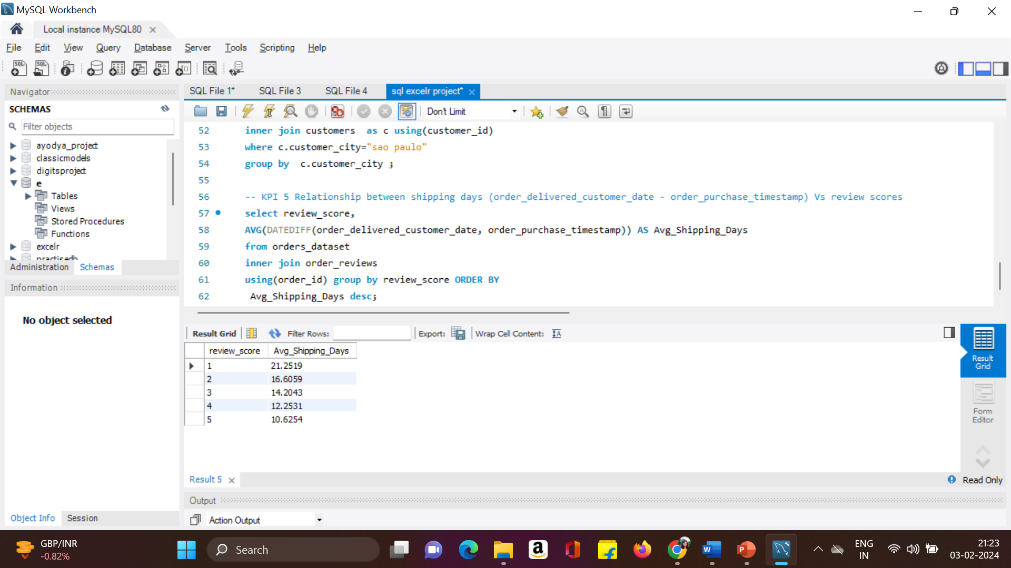
KPI 5) Relationship between shipping days (order_delivered_customer_date - order_purchase_timestamp) Vs review scores

Slide 7
THANK YOU

